Slide 2

KYOTO OFFICE MARKET
2025Q3
KYOTO
Q3 2025
2019年 1月

Slide 3
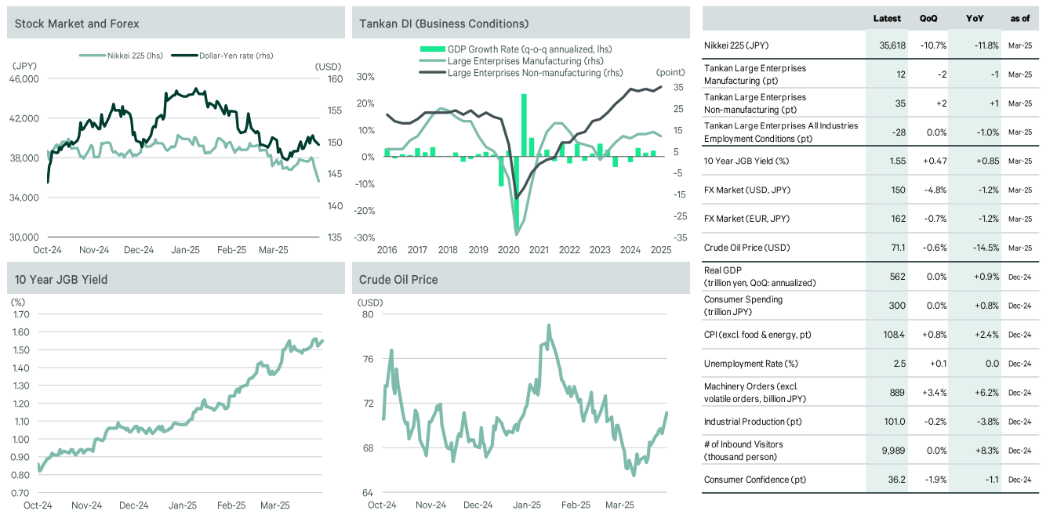
MACRO ECONOMY
KYOTO OFFICE MARKET
2025Q3
The latest (2025/9) BoJ Tankan survey showed that the business sentiment diffusion index (D.I.) for large manufacturers improved slightly by 1 pp q-o-q for the second consecutive quarter. The progress in Japan-U.S. tariff negotiations has somewhat eased uncertainty about the outlook, leading to improvements primarily in the manufacturing sector, including automobiles, shipbuilding, heavy machinery, and electrical machinery. Meanwhile, the business sentiment D.I. for large non-manufacturers remained unchanged. Although accommodation and food services deteriorated due to labor shortages and other factors, construction and information services improved, backed by progress in cost pass-through and robust capital investment appetite. Meanwhile, the outlook for both manufacturers and non-manufacturers deteriorated. The employment D.I. (all sizes and industries) worsened by 1 pp q-o-q. With unemployment rates remaining at historically low levels, the sense of labor shortage remains strong.

Slide 4
Vacancy rate expected rental price comparison by city
KYOTO OFFICE MARKET
2025Q3
The vacancy rate fell in eight out of 13 cities, rose in three, and remained unchanged in two; assumed achievable rents rose in 12 cities, and fell in one
Figure 2 : Vacancy Rate
Figure 3 : Assumed Achievable Rent
q-o-q change（pts）
q-o-q change（pts）
Tokyo Grade A
Tenant demand remained strong nationwide in Q3. In Yokohama, Nagoya, and Fukuoka, vacancy rates dropped relatively sharply as vacancies were filled by tenants looking to expand or upgrade their offices, improve office location, move to temporary premises for the purposes of rebuilding, or open new offices. Meanwhile, vacancy rates rose in Sapporo, Kanazawa, and Kyoto due to new supply, albeit firm demand.
All-grade rents rose q-o-q in all cities except Kanazawa. In the three major cities, rents were driven upward by strong tenant demand, particularly for newer, large-scale buildings in central locations. Rents in Osaka and Nagoya reached their historical highs. Among other cities, Yokohama, Sendai, and Takamatsu saw high rental growth rates, each rising over 1% q-o-q. Rents in Sapporo, Saitama, and Hiroshima also set new record highs this quarter.&nbsp;
Tokyo Grade A minus
Tokyo Grade B
Tokyo All Grade
Osaka Grade A
Osaka Grade B
Osaka All Grade
Nagoya Grade A
Nagoya Grade B
Nagoya All Grade
Yokohama
Saitama
Sapporo
Sendai
Kanazawa
Kyoto
Kobe
Hiroshima
Takamatsu
Fukuoka

Slide 5
EXECUTIVE SUMMARY
KYOTO OFFICE MARKET
2025Q3
 | Vacancy Rage
 | 2025/09 | 2025/06 | q-o-q change | 2024/09 | y-o-y change
All Grade | 2.8% | 2.0% | +0.8 | 2.4% | +0.4
Large scale bld. | 1.3% | 1.6% | -0.3 | 2.1% | -0.8
 | Assumed Achievable Rent(with CAM)
 | 2025/09 | 2025/06 | q-o-q change | 2024/09 | y-o-y change
All Grade | 15,510 (JPY/Tsubo) | 15,430 (JPY/Tsubo) | 0.5% | 15,390 (JPY/Tsubo) | 0.8%
Large scale bld. | 23,100 (JPY/Tsubo) | 23,000 (JPY/Tsubo) | 0.4% | 22,900 (JPY/Tsubo) | 0.9%
 | Definition
Large Scale Building | Office building for lease located in kyoto with floor plate of more than 300 tsubo or GFA_x000D_ of more than 10,000 tsubo and compliant with the new earthquake resistance standard.
All-Grade | Office building for lease located in kyoto with GFA of more than 1,000 tsubo and compliant with the new earthquake resistance standard.
Vacancy Rate | Vacancies are those that are ready to receive tenants at time of survey.
Availability Rate | % of spaces on offer, including a) physically vacant spaces; b) spaces which are expected to be physically vacant within the next 12 months; and c) spaces being offered in buildings slated for completion over the next 12 months.
Assumed Achievable Rent | Assumed achievable basis, for new leases.Assuming whole floor occupancy on mid-level floor. Net Effective Rents include CAM, assumes free rent and averaged over lease term. Face rents do not include free rent and other incentives.

Slide 6
VACANCY RATE
KYOTO OFFICE MARKET
2025Q3
q-o-q change | Down | Large scale bld.(-0.3pts)
 | Unchanged | None
 | Rose | All Grade(+0.8pts)
(%)
↑ Ranking | 1 | +1.1pts | 2 | +0.8pts | 3 |  | 4 |  | 5
 |  | Shijo-Karasuma All Grade(3.3%) |  | Kyoto All Grade(2.8%)
↓ Ranking |  | -0.3pts
 |  | Kyoto Eki All Grade(0.5%)

Slide 7
Assumed Achievable Rent
KYOTO OFFICE MARKET
2025Q3
q-o-q change | Rose | Kyoto(+0.4%)、Kyoto All Grade(+0.5%)、Kyoto Eki All Grade(+0.4%)、Shijo-Karasuma All Grade(+0.5%)
 | Unchanged | None
 | Down | None
(JPY/Tsubo)
(JPY/Tsubo)
↓ Ranking | 1 |  | 2 |  | 3 |  | 4 |  | 5

Slide 8
Scale Buildings
KYOTO OFFICE MARKET
2025Q3
Vacancy Rate by Submarket

Slide 9
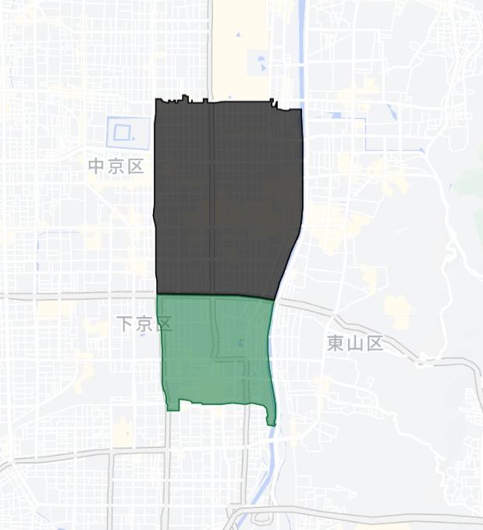
VACANCY RATE AND RENT CHART BY
SUBMARKET
KYOTO OFFICE MARKET
2025Q3
Submarket | Vacancy Rate |  |  | Assumed achievable Rent
 | 2025Q3 | q-o-q change | y-o-y change | 2025Q3 | q-o-q change | y-o-y change
Kyoto Eki | 0.5% | -0.3% | -2.0% | 17,780 | +0.4% | +1.5%
Shijo-Karasuma | 3.3% | +1.1% | +1.0% | 15,150 | +0.5% | +0.7%

Slide 10
By large
KYOTO OFFICE MARKET
2025Q3
building submarket Vacancy rate
4.7%
7.3%
(%)

Slide 11
Large building
KYOTO OFFICE MARKET
2025Q3
By sub-macket Assumed contracted rent
15,510
17,780
15,150

Slide 12
All Grade
KYOTO OFFICE MARKET
2025Q3
New Supply・New Demand・Vacancy Rate

Slide 13
MAJOR FUTURE PROJECTS
KYOTO OFFICE MARKET
2025Q3
Building in Red: GFA more than 10,000 tsubo
年 | 2025 |  |  |  |  |  |  |  |  |  |  |  | 2026 |  |  |  |  |  |  |  |  |  |  |  | 2027 |  |  |  |  |  |  |  |  |  |  |  | 2028 |  |  |  |  |  |  |  |  |  |  |  | 2029
 | Q1 |  |  | Q2 |  |  | Q3 |  |  | Q4 |  |  | Q1 |  |  | Q2 |  |  | Q3 |  |  | Q4 |  |  | Q1 |  |  | Q2 |  |  | Q3 |  |  | Q4 |  |  | Q1 |  |  | Q2 |  |  | Q3 |  |  | Q4 |  |  | Q1 |  |  | Q2 |  |  | Q3 |  |  | Q4
Kyoto Other
Kyoto Eki
Shijo-Karasuma
*as of 2025 Q3
Source: Information disclosed by developers and information reported by media and others

Slide 14


